Slide 1
Cookbook for Practice 6.2
实践6.2攻略
Cong Li 李聪

Slide 2
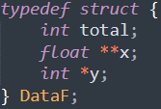
Look at the Customized Header
看看自己定制的头文件
Duplicate ‘simple.cpp’ as ‘float.cpp’
将’simple.cpp’复制为’float.cpp’
Inside the existing ‘data.h’, we see
在已有的’data.h’中我们看到
Training/test data in single-precision data type
用单精度类型表示的训练/测试数据
A function to read single-precision data from file
从文件中读取单精度数据的函数

Slide 3


Change Data Type
改变数据类型 (1)
Change double-precision data types to single-precision data types
将双精度类型改成单精度类型

Slide 4
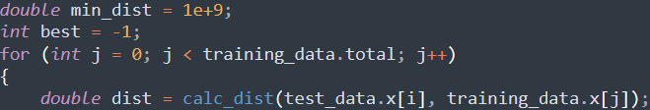
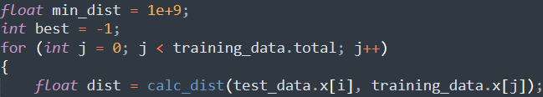
Change Data Type
改变数据类型 (2)

Slide 5
Run It 运行之
Change data reading functions & structure type from
将读取数据的函数和结构类型
to
改为
Compile & run it 编译并运行之
mingw32-make SRC=float.cpp
run-float.exe

Slide 6
The End

